Slide 1

Dijkstra’s Algorithm
Presented by:
Elizer Ponio Jr.
Department of Computer Science
College of Computing and Information Technologies

Slide 2
Do you ever wonder how Waze and Google Maps finds the shortest route?

Slide 3
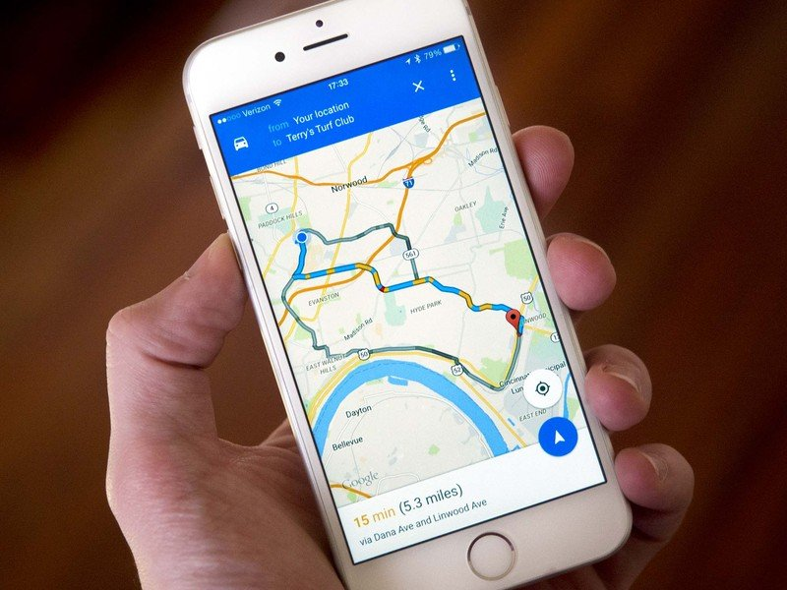
Finding the shortest path has become a part of our lives

Slide 4
Shortest Path
Finding the shortest path is a minimization problem.
A minimization problem is an optimization problem.
Optimization problems can be solved by greedy methods

Slide 5
Greedy Methods
In greedy methods, problems are solved in stages by taking one step at a time and considering one input at a time to get the optimal solution.
A greedy algorithm is an approach for solving a problem by selecting the best option available at the moment.
It doesn't worry whether the current best result will bring the overall optimal result.
Notes:
Greedy methods are have pre defined procedures and we follow those procedures to get the optimal solution.

Slide 6
Finding the Shortest Path
Bus
7-11
McDo
Tricycle
Tricycle
Jeep
Home
Jeep
BDO
Tricycle
NU
Tricycle
Bus
SM
KFC
LRT
What is the path with the least amount of rides/steps from home to school?

Slide 7
Finding the Shortest Path
Bus
7-11
McDo
Tricycle
Tricycle
Jeep
Home
Jeep
BDO
Tricycle
NU
Tricycle
Bus
SM
KFC
LRT
Route One: Home -> SM -> KFC -> Mcdo -> NU 4 Rides

Slide 8
Finding the Shortest Path
Bus
7-11
McDo
Tricycle
Tricycle
Jeep
Home
Jeep
BDO
Tricycle
NU
Tricycle
Bus
SM
KFC
LRT
Route Two: Home -> SM -> BDO -> Mcdo -> NU 4 Rides

Slide 9
Finding the Shortest Path
Bus
7-11
McDo
Tricycle
Tricycle
Jeep
Home
Jeep
BDO
Tricycle
NU
Tricycle
Bus
SM
KFC
LRT
Route Three: Home -> 7-11 -> SM -> BDO -> Mcdo -> NU 5 Rides

Slide 10
Finding the Shortest Path
Bus
7-11
McDo
Tricycle
Tricycle
Jeep
Home
Jeep
BDO
Tricycle
NU
Tricycle
Bus
SM
KFC
LRT
Route Four: Home -> 7-11 -> SM -> KFC -> Mcdo -> NU 5 Rides

Slide 11
Finding the Shortest Path
Bus
7-11
McDo
Tricycle
Tricycle
Jeep
Home
Jeep
BDO
Tricycle
NU
Tricycle
Bus
SM
KFC
LRT
Route Five: 7-11 -> Mcdo -> NU 3 Rides

Slide 12
We found the shortest path using Breadth First Search!
But the shortest path is not always the fastest path!

Slide 13
Fastest Path
21 mins
7-11
McDo
4 mins
4 mins
5 mins
Home
2 mins
BDO
12 mins
NU
10 mins
5 mins
SM
KFC
8 mins
What is the path with the least amount of travel time from home to school?

Slide 14
Fastest Path
21 mins
7-11
McDo
4 mins
4 mins
5 mins
Home
2 mins
BDO
12 mins
NU
10 mins
5 mins
SM
KFC
8 mins
Route Five: 7-11 -> Mcdo -> NU 29 minutes

Slide 15
Dijkstra’s Algorithm
Dijkstra's algorithm allows us to find the path with the least amount of cost between any two vertices of a weighted graph.

Slide 16
Steps
Find the “cheapest“ node. This is the node you can get to in the least amount of time.
Update the costs of the neighbors of this node.
Repeat until you have done this for every node in the graph.
Calculate the final path.

Slide 17
Dijkstra’s Algorithm
4
∞
21 mins
7-11
McDo
4 mins
4 mins
5 mins
∞
Home
2 mins
BDO
12 mins
NU
10 mins
5 mins
∞
SM
KFC
8 mins
10
∞
Put the cost for nodes that are adjacent from the starting point
Put ∞ for nodes that are non-adjacent from the starting point

Slide 18
Dijkstra’s Algorithm
4
16
∞
21 mins
7-11
McDo
4 mins
4 mins
5 mins
20
∞
Home
2 mins
BDO
12 mins
NU
11
10 mins
5 mins
∞
SM
KFC
8 mins
6
∞
10
Route Three: Home -> 7-11 -> SM -> BDO -> Mcdo -> NU 20 minutes

Slide 19
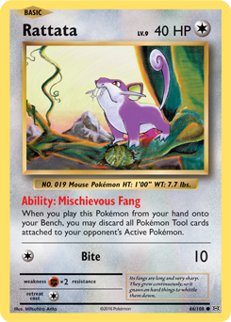
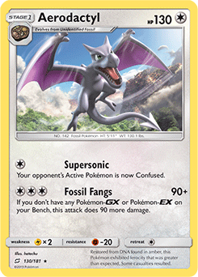

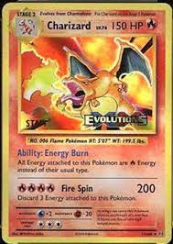


Other use cases
$ 15
$ 5
$ 20
$ 20
$ 30
$ 0
$ 10
Trade your way for a better card
You can use Dijkstra’s algorithm to trade for a better card with spending the least amount of money.
$ 35

Slide 20
Recap
Breadth-first search is used to calculate the shortest path for an unweighted graph.
Dijkstra’s algorithm is used to calculate the shortest path for weighted graphs.
Dijkstra’s algorithm works when all the weights are positive.
If you have negative weights, use the Bellman-Ford algorithm.

